Slide 1


Slide 2

Define motivation
Compare and contrast early theories of motivation
Compare and contrast contemporary theories of motivation
Discuss current issues in motivation

Slide 3

What Is Motivation?
Motivation - the process by which a person’s efforts are energized, directed, and sustained toward attaining a goal.

Slide 4
Early Theories of Motivation
Maslow’s Hierarchy of Needs
McGregor’s Theories X and Y
Herzberg’s Two-Factor Theory
McClelland’s Three Needs Theory

Slide 5
Maslow’s Hierarchy of Needs Theory
Hierarchy of needs theory - Maslow’s theory that human needs — physiological, safety, social, esteem, and self-actualization — form a sort of hierarchy.

Slide 6
Maslow’s Hierarchy of Needs Theory (cont.)
Physiological needs - a person’s needs for food, drink, shelter, sexual satisfaction, and other physical needs.
Safety needs - a person’s needs for security and protection from physical and emotional harm.
Social needs - a person’s needs for affection, belongingness, acceptance, and friendship.

Slide 7
Maslow’s Hierarchy of Needs Theory (cont.)
Esteem needs - a person’s needs for internal factors (e.g., self-respect, autonomy, and achievement) and external factors (such as status, recognition, and attention).
Self-actualization needs - a person’s need to become what he or she is capable of becoming.

Slide 8
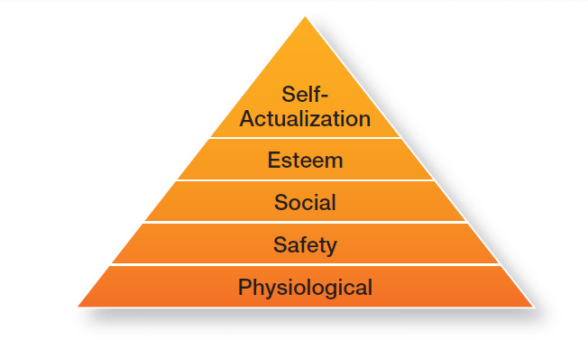
Exhibit 16-1: Maslow’s Hierarchy of Needs
Notes:
Maslow argued that each level in the needs hierarchy must be substantially satisfied before the next need becomes dominant. An individual moves up the needs hierarchy from one level to the next. (See Exhibit 16-1.)

Slide 9
McGregor’s Theory X and Theory Y
Theory X - the assumption that employees dislike work, are lazy, avoid responsibility, and must be coerced to perform.
Theory Y - the assumption that employees are creative, enjoy work, seek responsibility, and can exercise self-direction.

Slide 10

Herzberg’s Two-Factor Theory
Two-factor theory (motivation-hygiene theory) - the motivation theory that claims that intrinsic factors are related to job satisfaction and motivation, whereas extrinsic factors are associated with job dissatisfaction.

Slide 11
Herzberg’s Two-Factor Theory (cont.)
Hygiene factors - factors that eliminate job dissatisfaction, but don’t motivate.
Motivators - factors that increase job satisfaction and motivation.

Slide 12
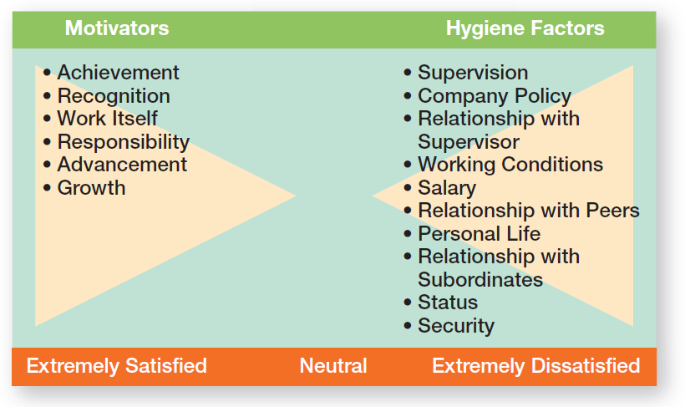
Exhibit 16-2: Herzberg’s Two Factor Theory
Notes:
Frederick Herzberg’s Two-Factor Theory (also called Motivation-Hygiene Theory) proposes that intrinsic factors are related to job satisfaction, while extrinsic factors are associated with job dissatisfaction. Herzberg wanted to know when people felt exceptionally good (satisfied) or bad (dissatisfied) about their jobs. (These findings are shown in Exhibit 16-2.)

Slide 13
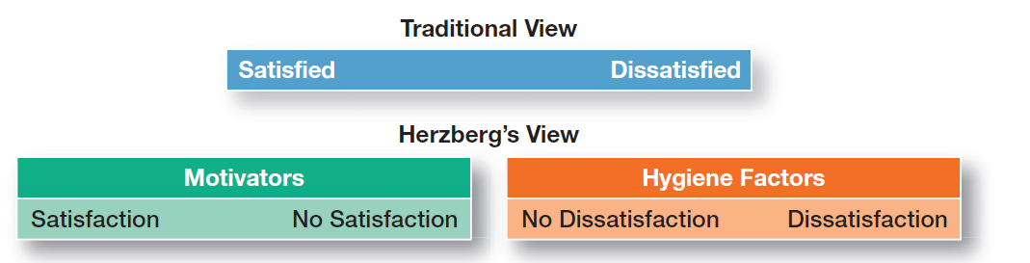
Exhibit 16-3: Contrasting Views of Satisfaction-Dissatisfaction
Notes:
As shown in Exhibit 16-3, Herzberg proposed that a dual continuum existed: The opposite of “satisfaction” is “no satisfaction,” and the opposite of “dissatisfaction” is “no dissatisfaction.”

Slide 14
Three-Needs Theory (McClelland)
Three-needs theory - the motivation theory that sites three acquired (non-innate) needs (achievement, power, and affiliation) as major motives in work.
Need for achievement (nAch) - the drive to succeed and excel in relation to a set of standards.

Slide 15
Three-Needs Theory (cont.)
Need for power (nPow) - the need to make others behave in a way that they would not have behaved otherwise.
Need for affiliation (nAff) - the desire for friendly and close interpersonal relationships.

Slide 16
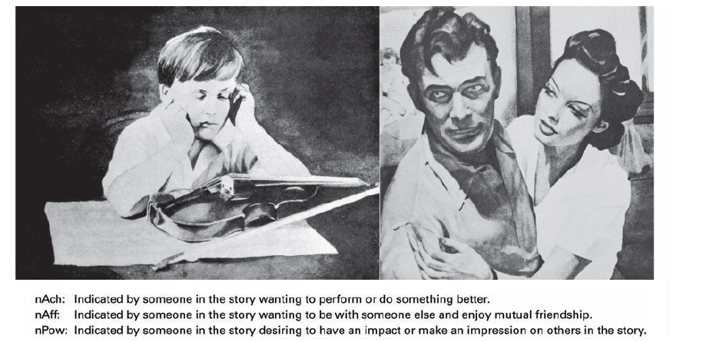
Exhibit 16-4: TAT Pictures
Notes:
All three of these needs can be measured by using a projective test (known as the Thematic Apperception Test or TAT) in which respondents react to a set of pictures. Each picture is briefly shown to a person who writes a story based on the picture (see Exhibit 16-4 for some examples). Trained interpreters then determine the individual’s levels of nAch, nPow, and nAff from the stories written.

Slide 17
Contemporary Theories of Motivation
Goal-setting theory - the proposition that specific goals increase performance and that difficult goals, when accepted, result in higher performance than do easy goals.
Self-efficacy - an individual’s belief that he or she is capable of performing a task.

Slide 18
Contemporary Theories of Motivation (cont.)
Reinforcement theory - the theory that behavior is a function of its consequences.
Reinforcers - consequences immediately following a behavior which increase the probability that the behavior will be repeated.

Slide 19
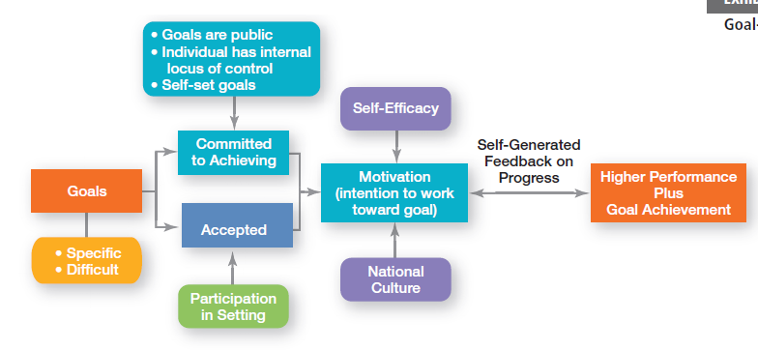
Exhibit 16-5: Goal-Setting Theory
Notes:
Exhibit 16-5 summarizes the relationships among goals, motivation, and performance. Our overall conclusion is that the intention to work toward difficult and specific goals is a powerful motivating force. Under the proper conditions, it can lead to higher performance. However, no evidence indicates that such goals are associated with increased job satisfaction.

Slide 20
Designing Motivating Jobs
Job design - the way tasks are combined to form complete jobs.
Job scope - the number of different tasks required in a job and the frequency with which those tasks are repeated.
Job enlargement - the horizontal expansion of a job that occurs as a result of increasing job scope.

Slide 21
Designing Motivating Jobs (cont.)
Job enrichment - the vertical expansion of a job that occurs as a result of additional planning and evaluation of responsibilities.
Job depth - the degree of control employees have over their work.
Job characteristics model (JCM) - a framework for analyzing and designing jobs that identifies five primary core job dimensions, their interrelationships, and their impact on outcomes.

Slide 22
Five Core Job Dimensions
Skill variety - the degree to which a job requires a variety of activities so that an employee can use a number of different skills and talents.
Task identity - the degree to which a job requires completion of a whole and identifiable piece of work.

Slide 23
Five Core Job Dimensions (cont.)
Task significance - the degree to which a job has a substantial impact on the lives or work of other people.
Autonomy - the degree to which a job provides substantial freedom, independence, and discretion to the individual in scheduling work and determining the procedures to be used in carrying it out.

Slide 24
Five Core Job Dimensions (cont.)
Feedback - the degree to which carrying out work activities required by a job results in the individual’s reception of direct and clear information about his or her performance effectiveness.

Slide 25
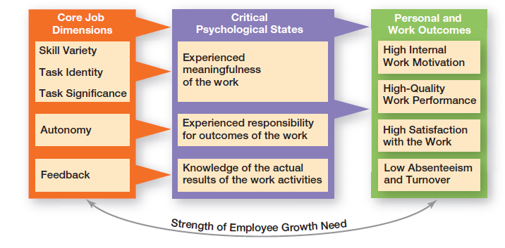
Exhibit 16-6: Job Characteristics Model
Notes:
The JCM is shown in Exhibit 16-6. Notice how the first three dimensions—skill variety, task identity, and task significance—combine to create meaningful work. In other words, if these three characteristics exist in a job, we can predict that the person will view his or her job as being important, valuable, and worthwhile.

Slide 26
Redesigning Job Design Approaches
Relational perspective of work design - an approach to job design that focuses on how people’s tasks and jobs are increasingly based on social relationships.
Proactive perspective of work design - an approach to job design in which employees take the initiative to change how their work is performed.

Slide 27
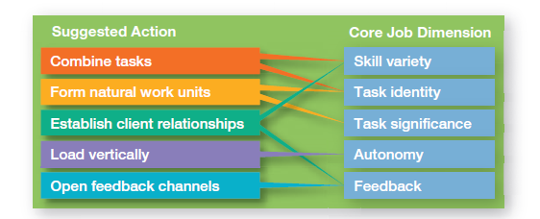
Exhibit 16-7: Guidelines for Job Redesign
Notes:
The JCM provides specific guidance to managers for job design (see Exhibit 16-7). These suggestions specify the types of changes that are most likely to lead to improvement in the five core job dimensions.

Slide 28

Redesigning Job Design Approaches (cont.)
High-involvement work practices - work practices designed to elicit greater input or involvement from workers.

Slide 29
Equity Theory
Equity theory - the theory that an employee compares his or her job’s input-outcome ratio with that of relevant others and then corrects any inequity.
Referents - the persons, systems, or selves against which individuals compare themselves to assess equity.
Distributive justice - perceived fairness of the amount and allocation of rewards among individuals.

Slide 30
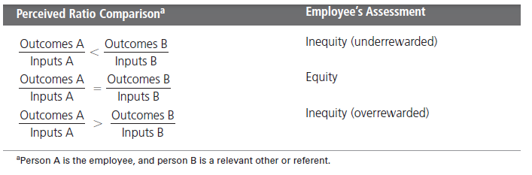
Exhibit 16-8: Equity Theory
Notes:
Equity theory, developed by J. Stacey Adams, proposes that employees compare what they get from a job (outcomes) in relation to what they put into it (inputs), and then they compare their inputs–outcomes ratio with the inputs–outcomes ratios of relevant others (Exhibit 16-8).

Slide 31
Expectancy Theory
Expectancy theory - the theory that an individual tends to act in a certain way based on the expectation that the act will be followed by a given outcome and on the attractiveness of that outcome to the individual.

Slide 32
Expectancy Theory
Expectancy Relationships
Expectancy (effort-performance linkage)
The perceived probability that an individual’s effort will result in a certain level of performance.
Instrumentality
The perception that a particular level of performance will result in attaining a desired outcome (reward).
Valence
The attractiveness/importance of the performance reward (outcome) to the individual.

Slide 33
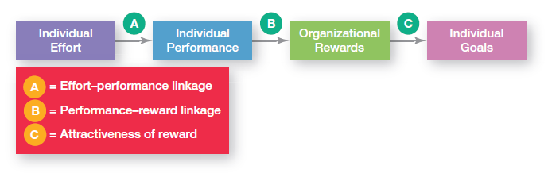
Exhibit 16-9: Expectancy Model
Notes:
Expectancy theory states that an individual tends to act in a certain way based on the expectation that the act will be followed by a given outcome and on the attractiveness of that outcome to the individual. It includes three variables or relationships (see Exhibit 16-9).

Slide 34
Current Issues in Motivation
Cross-Cultural Challenges
Motivational programs are most applicable in cultures where individualism and achievement are cultural characteristics.
Uncertainty avoidance of some cultures inverts Maslow’s needs hierarchy.
The need for achievement (nAch) is lacking in other cultures.
Collectivist cultures view rewards as “entitlements” to be distributed based on individual needs, not individual performance.

Slide 35
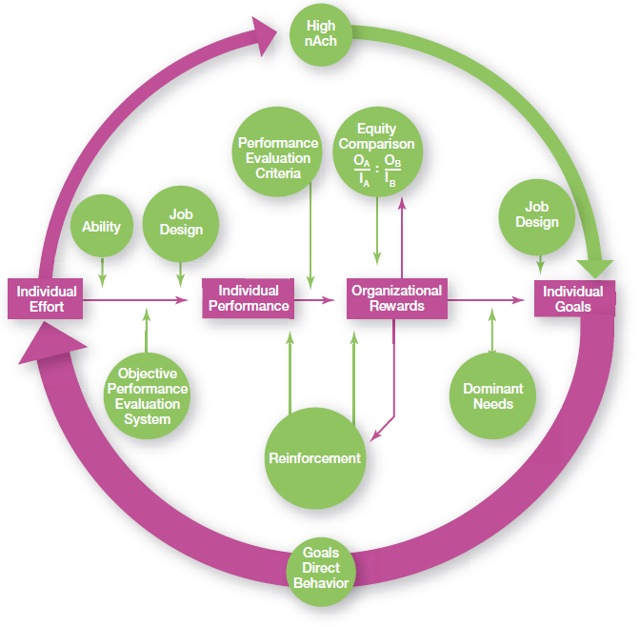
Exhibit 16-10: Integrating Contemporary Theories of Motivation
Notes:
Many of the ideas underlying the contemporary motivation theories are complementary, and you’ll understand better how to motivate people if you see how the theories fit together. Exhibit 16-10 presents a model that integrates much of what we know about motivation. Its basic foundation is the expectancy model.

Slide 36
Motivating Unique Groups of Workers
Motivating a Diverse Workforce
Motivating a diverse workforce through flexibility:
Men desire more autonomy than do women.
Women desire learning opportunities, flexible work schedules, and good interpersonal relations.

Slide 37
Motivating Unique Groups of Workers
Motivating a Diverse Workforce
Compressed workweek
Longer daily hours, but fewer days
Flexible work hours (flextime)
Specific weekly hours with varying arrival, departure, lunch and break times around certain core hours during which all employees must be present
Job Sharing
Two or more people split a full-time job
Telecommuting
Employees work from home using computer links

Slide 38
Motivating Unique Groups of Workers
Motivating Professionals
Characteristics of professionals
Strong and long-term commitment to their field of expertise
Loyalty is to their profession, not to the employer
Have the need to regularly update their knowledge
Don’t define their workweek as 8:00 am to 5:00 pm.

Slide 39
Motivating Unique Groups of Workers
Motivating Contingent Workers
Opportunity to become a permanent employee
Opportunity for training
Equity in compensation and benefits
Motivating Low-Skilled, Minimum-Wage Employees
Employee recognition programs
Provision of sincere praise

Slide 40
Designing Appropriate Rewards Programs
Open-book management - a motivational approach in which an organization’s financial statements (the “books”) are shared with all employees.
Employee recognition programs - programs based on personal attention and expression of interest, approval, and appreciation for a job well done.
Pay-for-performance programs - variable compensation plans that pay employees on the basis of some performance measure.

Slide 41
Terms to Know
Motivation
Hierarchy of needs theory
Physiological needs
Safety needs
Social needs
Esteem needs
Self-actualization needs
Theory X
Theory Y
Two-factor theory (motivation-hygiene theory)
Hygiene factors
Motivators
Three-needs theory
Need for achievement (nAch)
Need for power (nPow)
Need for affiliation (nAff)
Goal-setting theory
Self-efficacy
Reinforcement theory
Re-inforcers
Notes:
41

Slide 42
Terms to Know (cont)
Job design
Job scope
Job enlargement
Job enrichment
Job depth
Job characteristics model (JCM)
Skill variety
Task identity
Task significance
Autonomy
Feedback
Relational perspective of work design
Proactive perspective of work design
High-involvement work practices
Equity theory
Referents
Distributive justice
Procedural justice
Expectancy theory
Open-book management
Employee recognition programs
Notes:
42

